Slide 1

Difficulty and target

Slide 2
The difficulty is a number that regulates how long it takes for miners to add new blocks of transactions to the blockchain
difficulty adjusts every 2016 blocks
This difficulty value updates every 2 weeks to ensure that it takes 10 minutes (on average) to add a new block to the blockchain.

Slide 3
expected / actual
20160 / actual (2016x10)
20160 / 18144 = 1.11 (9 minutes x 2016)
difficulty x 1.11 = new difficulty
(If the number is greater than 1 (i.e. blocks were mined quicker than expected), the difficulty increases.
If the number is less than 1 (i.e. blocks were mined slower than expected) the difficulty decreases)

Slide 4
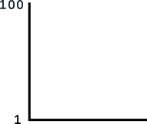

Slide 5
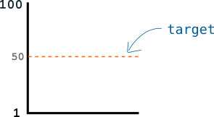

Slide 6
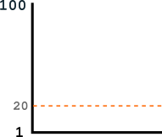

Slide 7
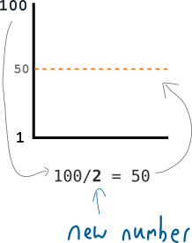

Slide 8
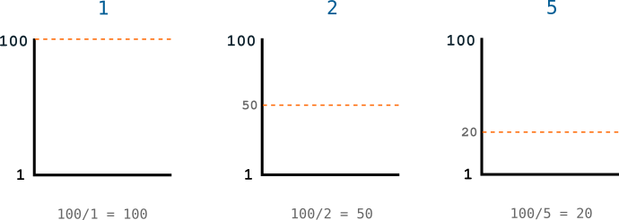

Slide 9
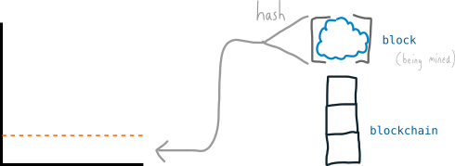

Slide 10
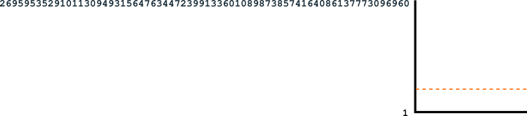

Slide 11
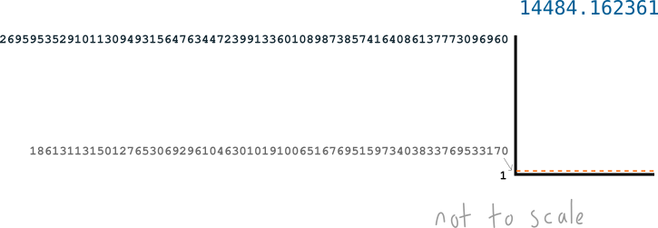

Slide 12
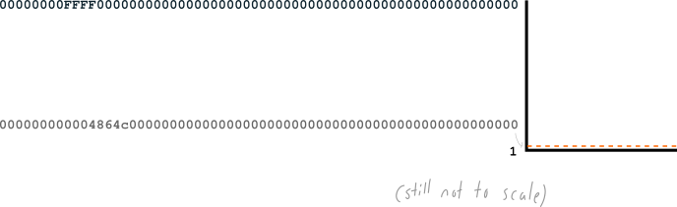

Slide 13
Hexadecimal | 000000000004864c000000000000000000000000000000000000000000000000
Decimal | 1861311314983800126815643622927230076368334845814253369901973504
Hexadecimal | 000000000003ba27aa200b1cecaad478d2b00432346c3f1f3986da1afd33e506
Decimal | 1533267872647776902154320487930659211795065581998445848740226310

Slide 14
Thank You

